Slide 1
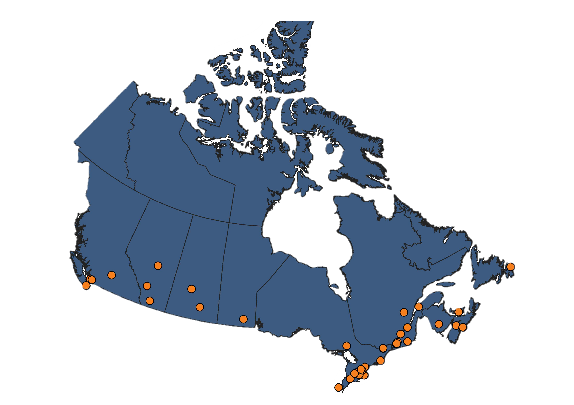

Slide 2
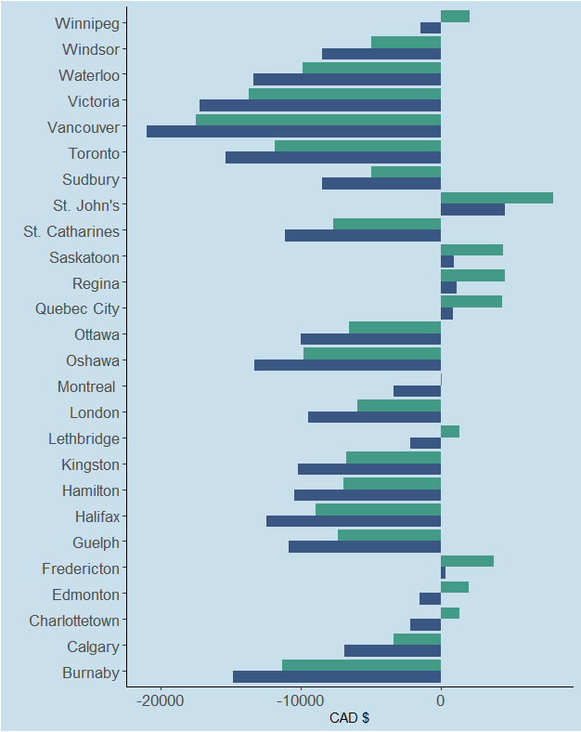
Canadian Universities with NSERC awards
Remaining income after rent* and tuition**
CGS-M
PGS-D
* Average July 2021 rent for a 1-bedroom apartment
** Full-time Canadian graduate student tuition 2021 – 2022 (StatsCan)

Slide 3
NSERC PDF
$45,000/yr
NSERC PGS-D
$21,000/yr
n=150
n=703*
n=610
n=1142*
* NSERC reports PGS-D/CGS-D combined
NSERC CGS-M
$17,500/yr
n=150
n=610

Slide 4
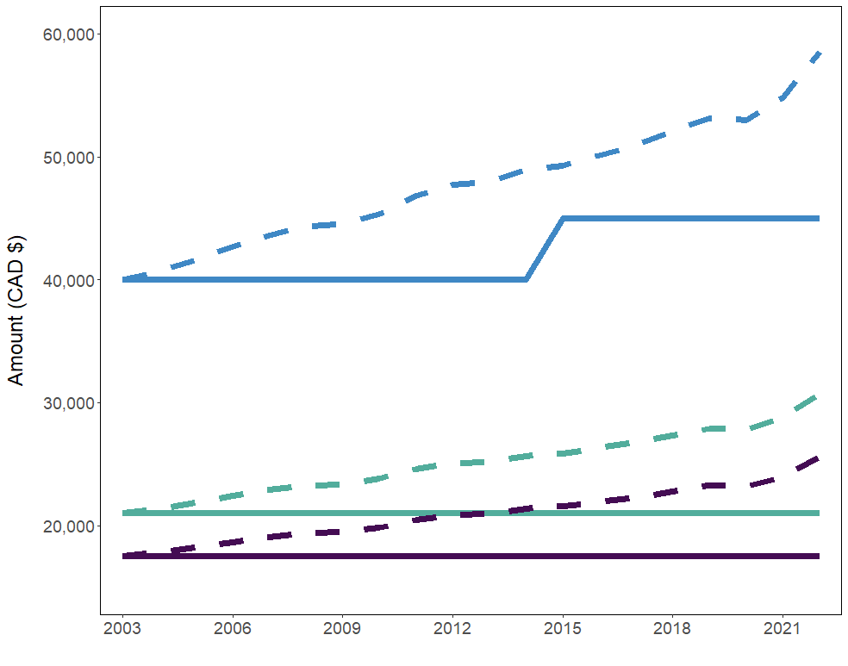
PDF Funding
PGS-D Funding
CGS-M Funding

